Slide 1

Database Systems and Web (15B11CI312)

Slide 2
Database Systems and Web
Lecture 2

Slide 3
Contents to be covered
Database Terms
Three-schema Architecture
Data Independence
Roles for people in DBMS
Database Languages and Interface
Data Models
Classification of DBMSs

Slide 4
Database Terms
Schema : A schema is a description of a particular collection of data, using a given data model.
Schema is the overall design of database.
In RDBMS context:
Schema – table names, attribute names with their data types for each table and constraints etc.
Name | Roll | Class | Subject

Slide 5
Database Terms
Database state : Data in a database at particular moment is called database state or snapshot.
Instances : It is sometimes called the current state or instances in database.
Example : Entry in student table.
Metadata : DBMS stores description of schema construct and constraints known as Metadata.
The Schema is sometimes called Intension and instance is called extension of schema.

Slide 6
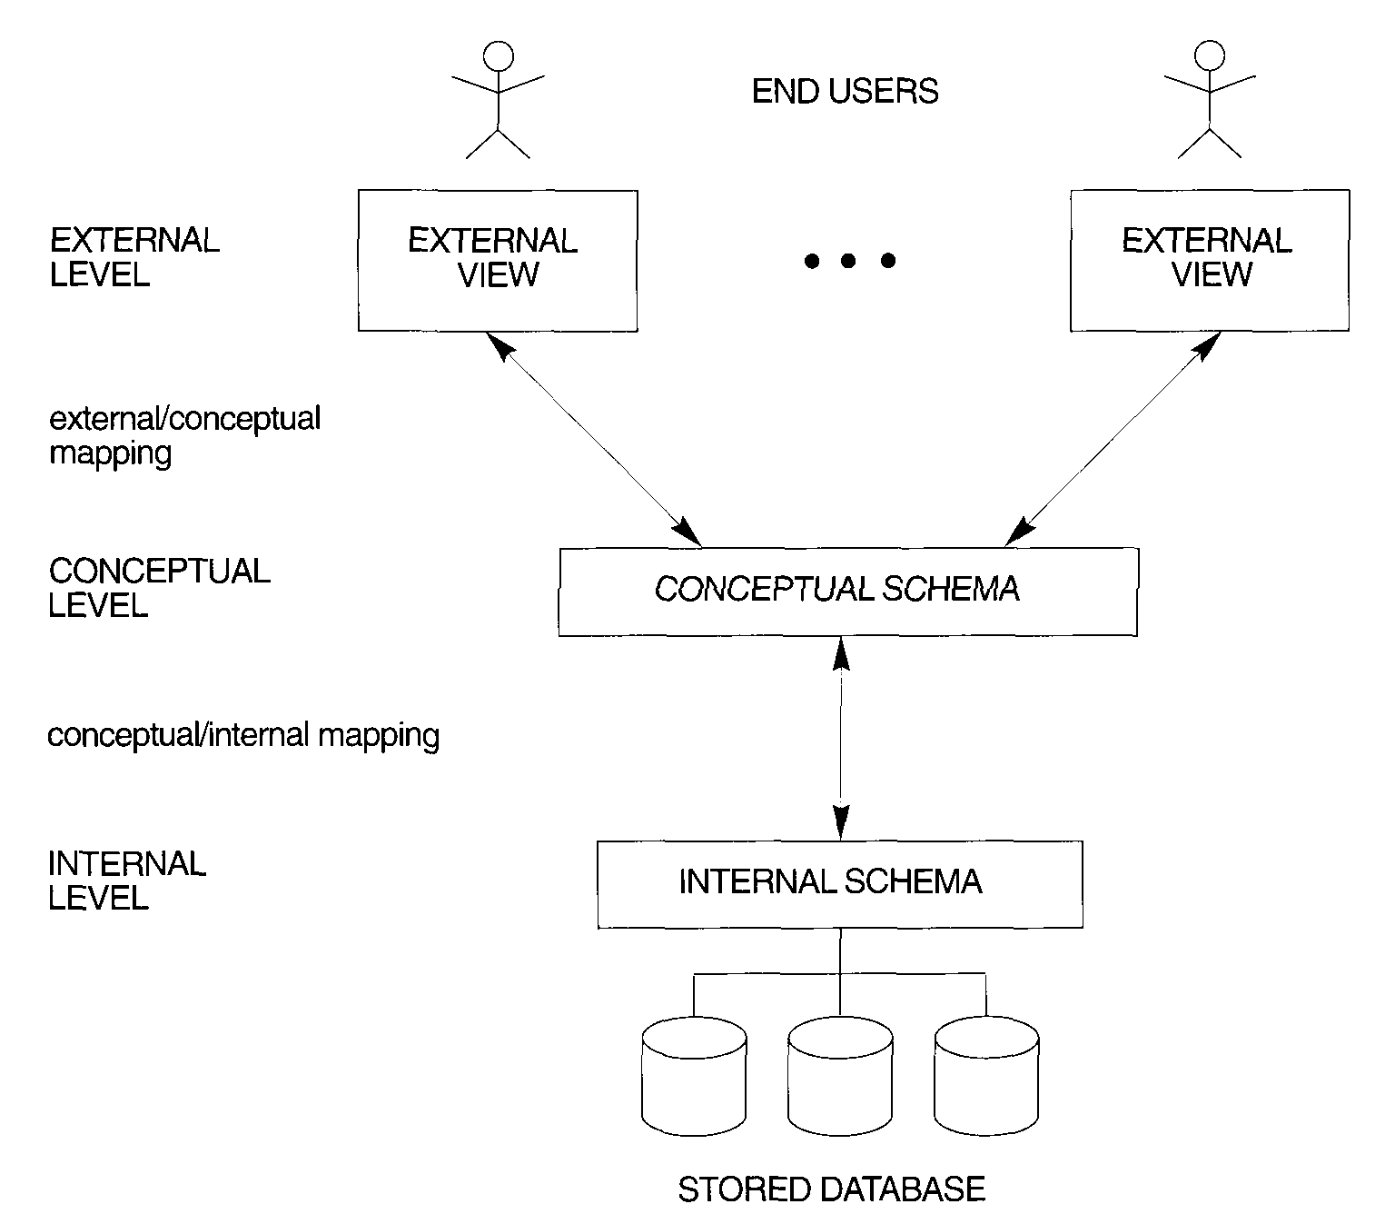
Three-schema Architecture
Reading Suggestion and image source: Elmasri and Navathe , ” FUNDAMENTALS OF DATABASE SYSTEMS”, Chapter 2

Slide 7
Three-schema Architecture
Physical level:
Describes details of how data is stored: files, indices, etc. on the random access disk system
It also typically describes the record layout of files and type of files (hash, b-tree, flat).

Slide 8
Three-schema Architecture
Conceptual level(logical):
Describes data stored in database, and the relationships among the data.
Hides details of the physical level.
In the relational model, the conceptual schema presents data as a set of tables

Slide 9
Three-schema Architecture
View level :
Each view describes an aspect of the database relevant to a particular group of users.
Portions of stored data should not be seen by some users and implement a level of security .
For Example, in the context of a library database
Books details section
Issue/Returns management section

Slide 10
Three-schema Architecture
 | External Level
 | Conceptual Level
Struct { String Sname String Lname Number Age } | Physical Level
Parents View
Library View
Roll N | Sname | CGPA
Roll N | Book Issued | Book Return
Relational Table
Roll N | Sname | CGPA | Book Issued | Book Return

Slide 11
Data Independence
Capacity to change schema at one level of database system without having to change schema at next higher level.
Physical data independence: The ability to modify physical level schema without affecting the logical or view level schema.
Logical data independence: The ability to change the logical level scheme without affecting the view level schemes or application programs.

Slide 12
Database Languages
Data Definition Language (DDL),
Data Manipulation Language (DML)
Data Control Language (DCL)
Transaction Control Language (TCL)

Slide 13
Database Interfaces
Web-based user interfaces.
Forms-Based Interfaces.
Graphical User Interfaces.
Natural Language Interfaces.
Interfaces for the DBA.

Slide 14
Roles for people in DBMS
Application programmers – interact with system through DML calls, develop user interfaces
Sophisticated users – form requests in a database query language
Specialized users – write specialized database applications that do not fit into the traditional data processing framework
Naive users – invoke one of the permanent application programs that have been written previously
E.g. people accessing database over the web, bank tellers, clerical staff
DBA (Database Administrator)
Designing the logical schema and Creating the structure of the entire database
Monitor usage and create necessary index structures to speedup query execution
Grant / Revoke data access permissions to other users etc

Slide 15
Data Models
A data model is a collection of concepts for describing data.
Data Models define underlying structure of DBMS.
Use to achieve data abstraction for creation of good database
Define and organize data according to users
Contains Description of data, data relationship ,data semantics , data integrity constraints.

Slide 16
Data Models
Type of data model
Object Based Logical data model
ER Model
OO Model
Record Based Logical Data Model
Relational Data Model
Hierarchical Data Model
Network Based

Slide 17
Data Models
The Relational model and ER Model of data is the most widely used model today.
ER Model: Describes the structure of a database with the help of a notations
Relational Model : Represent the database in form of a table with rows and columns.

Slide 18
Data Models
Example of database schema in the Entity-Relationship model
Student
Enroll
Courses

Slide 19
Data Models (cont…..)
Example of tabular data in the relational model
Student-id
Student-
name
CGPA
Attributes
10001
10002
Johnson
Smith
9.5
5.9
Database design in E-R model usually converted to design in the relational model (coming up next) which is used for storage and processing

Slide 20
Classification of DBMSs
General or special-purpose
Data model
•Relational
•Object
•Object-relational
•Hierarchical and network
Number of users
•Single-user and Multiuser
Number of sites
•Centralized
•Distributed
Licensing
•Open source
•commercial

